Slide 1
PRINCIPLE OF MATHEMATICAL INDUCTION
CONTENT
WHAT INDUCTION IS ?
HOW INDUCTION APPLIED?
PRACTICE QUESTIONS
THINGS TO REMEMBER
IMP FACTS OF PREVIOUS TOPIC

Slide 2
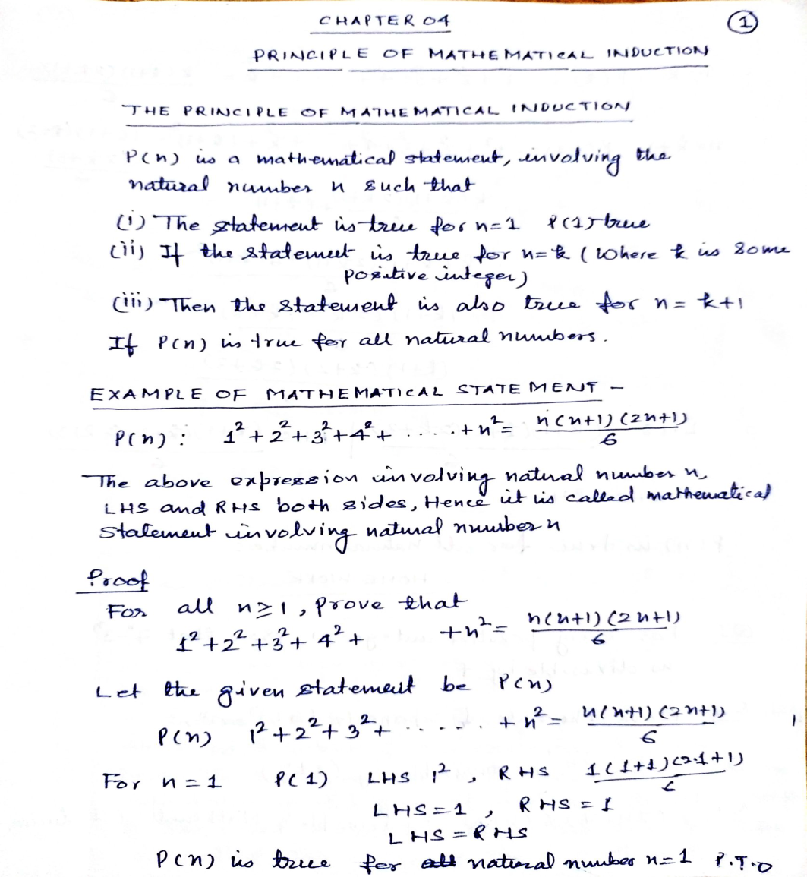

Slide 3
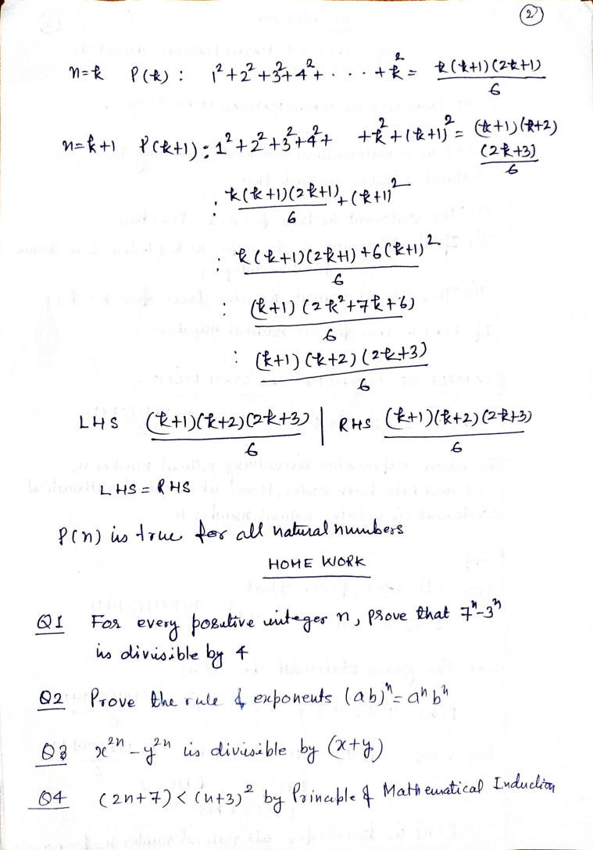

Slide 4
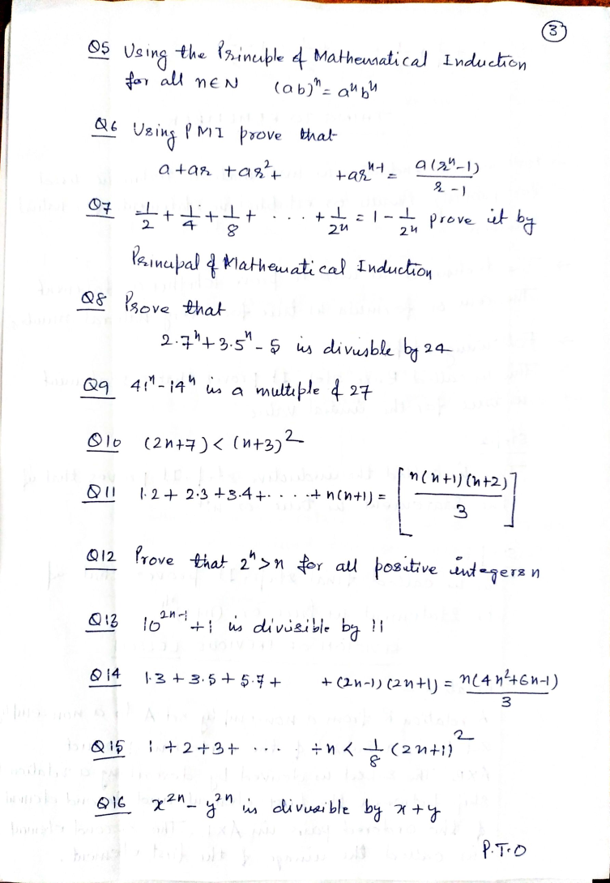

Slide 5
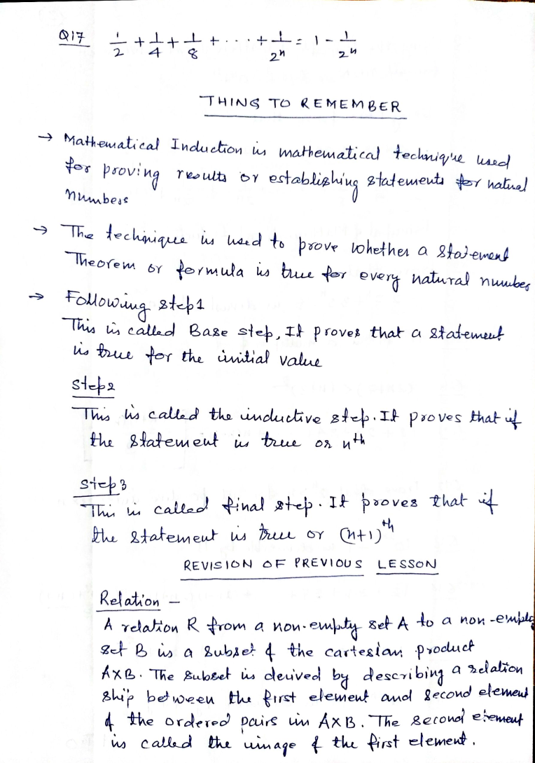

Slide 6
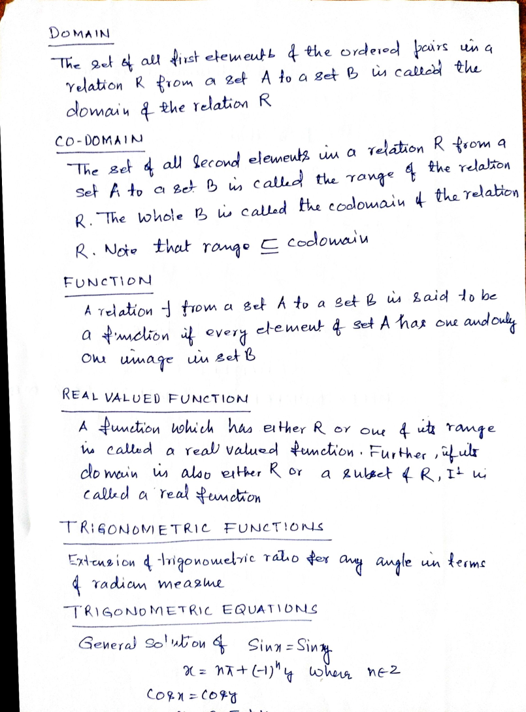
Some Facts From Previous Topic

